Slide 1
Reading Response and the 6th Graders
By Dustin Ballard

Slide 2
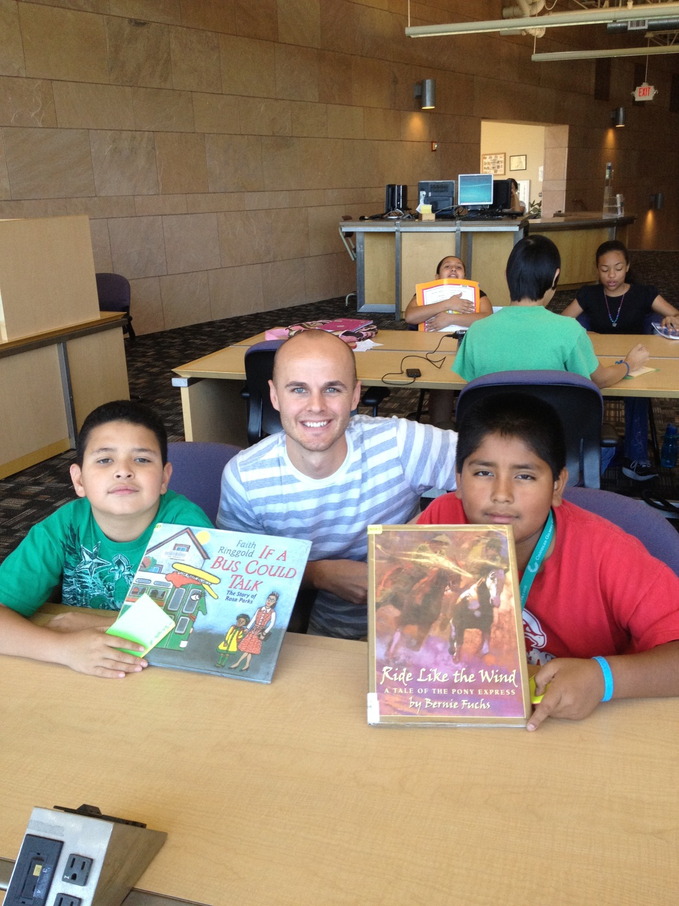
Geronimo and Jesus

Slide 3
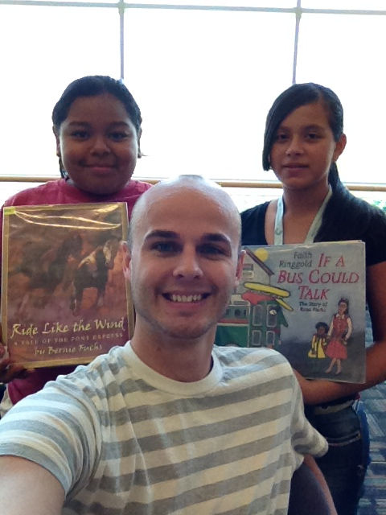
Christina
&
Jennifer

Slide 4
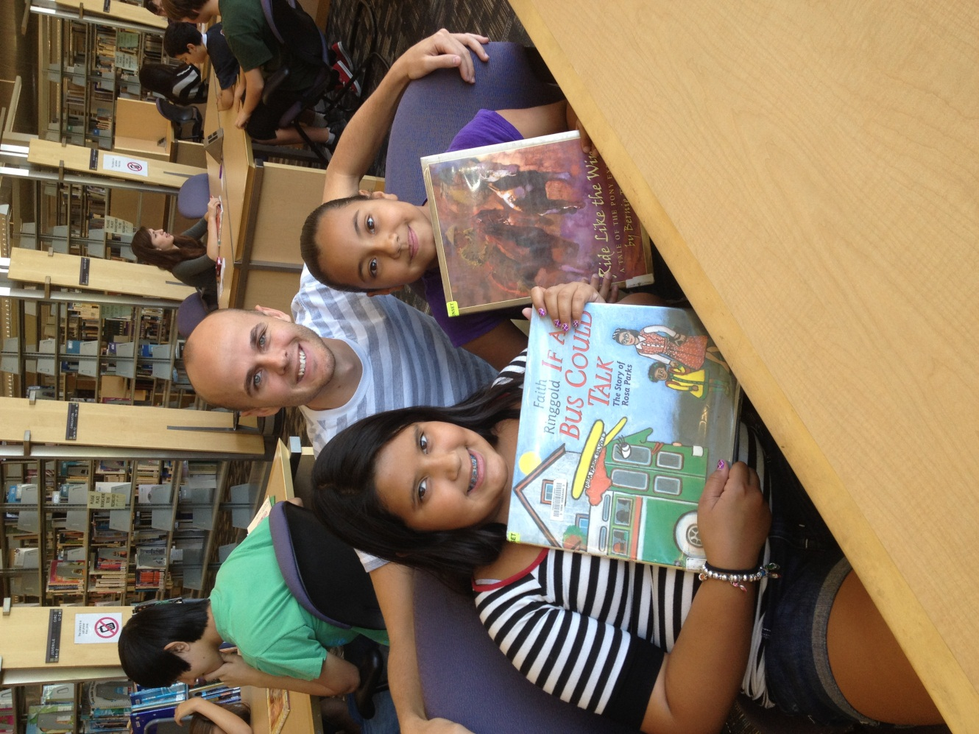
Stevie and Karla

Slide 5
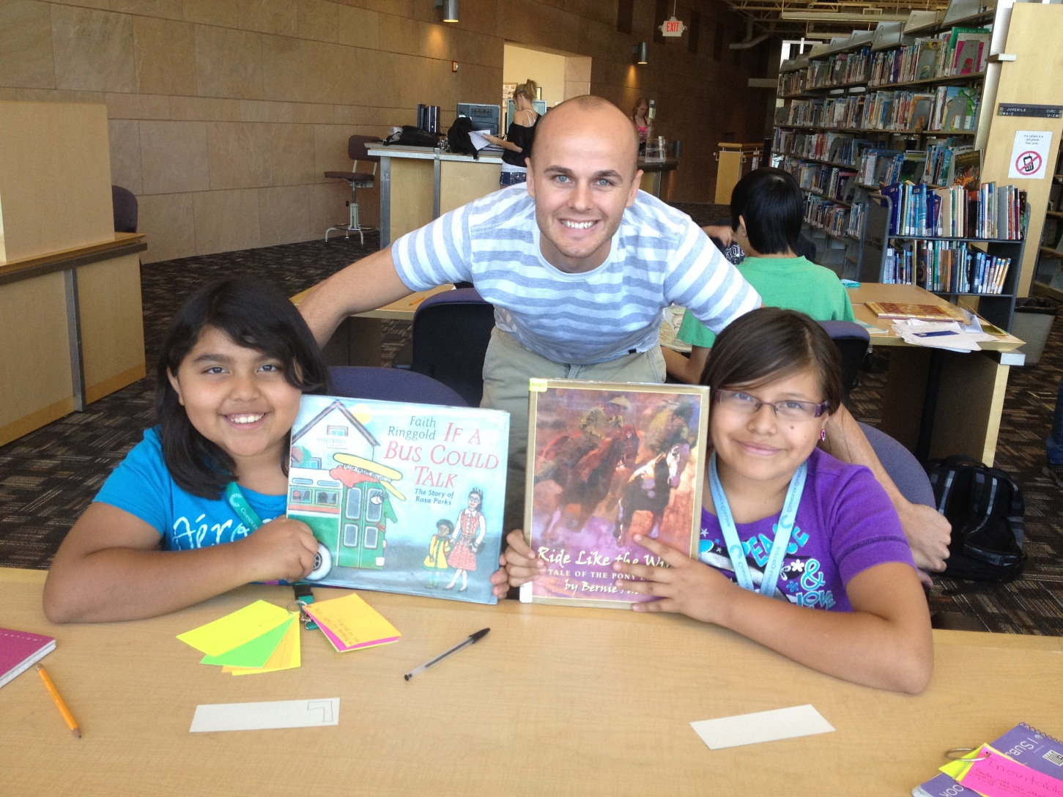
Ruth and Lucy

Slide 6
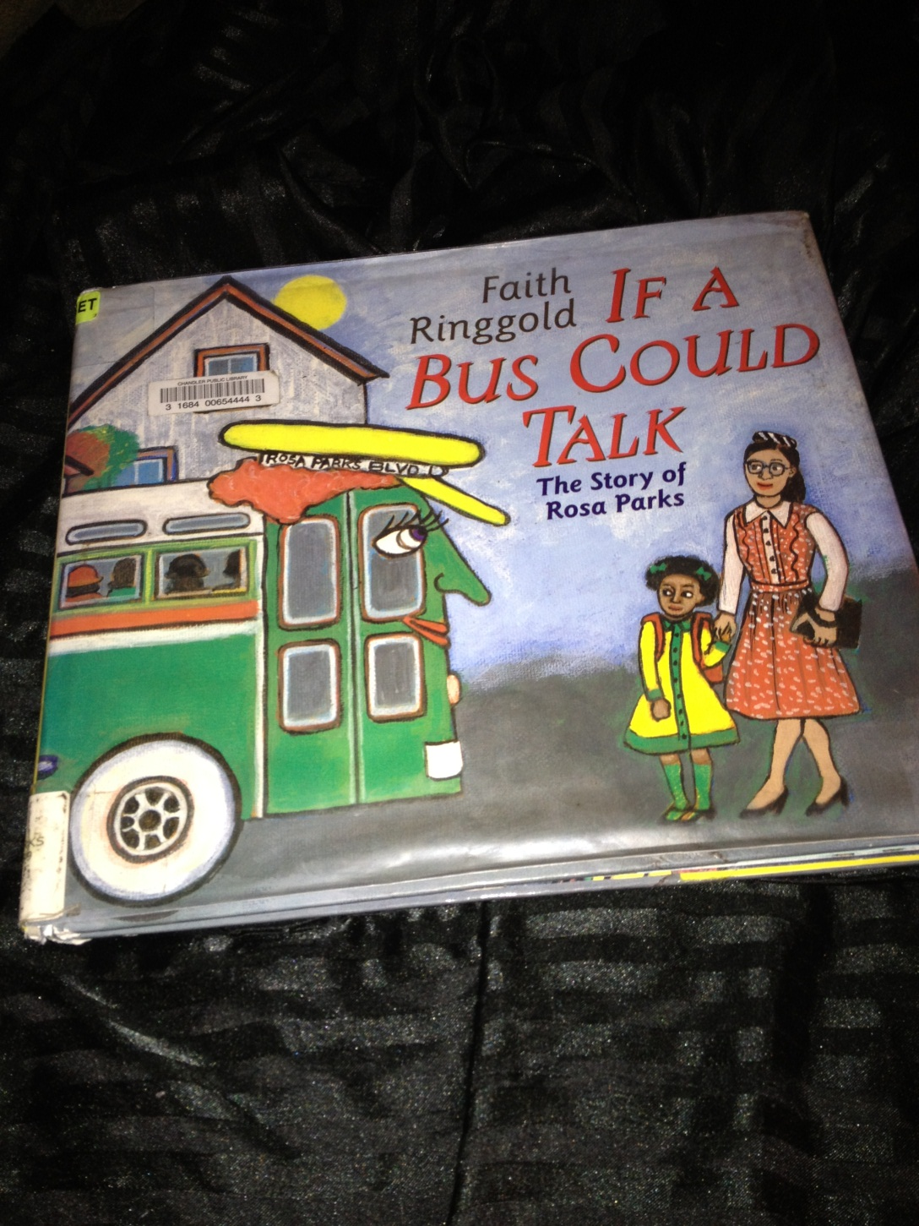
A Story about Rosa Parks
The Issue of Segregation

Slide 7
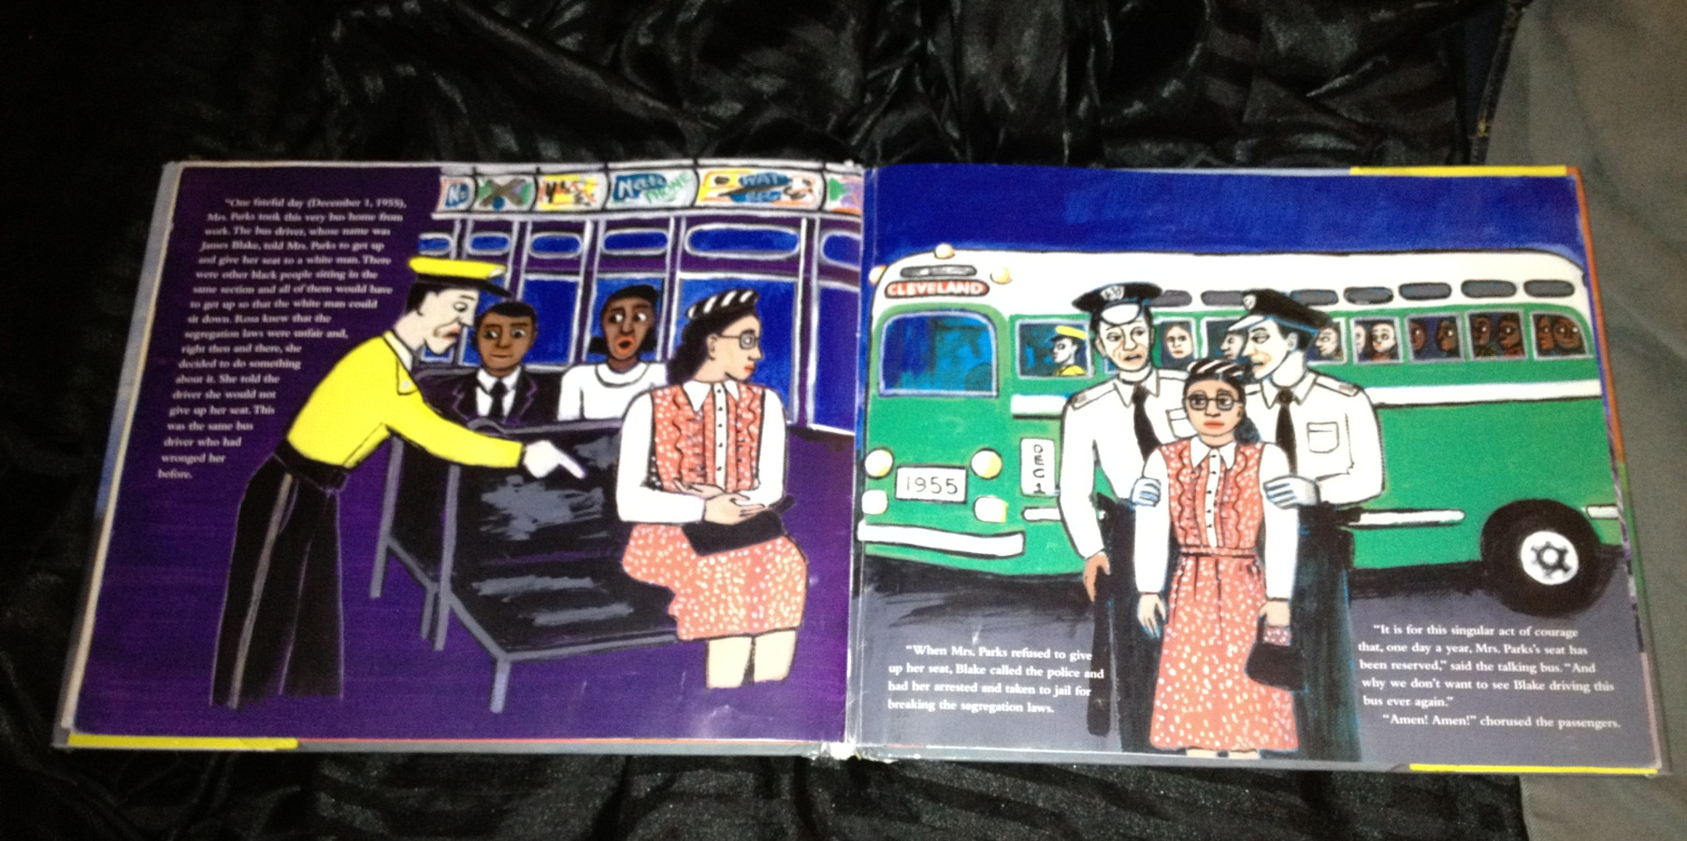
The Students were able to guess what happened on some pages, based on the pictures

Slide 8
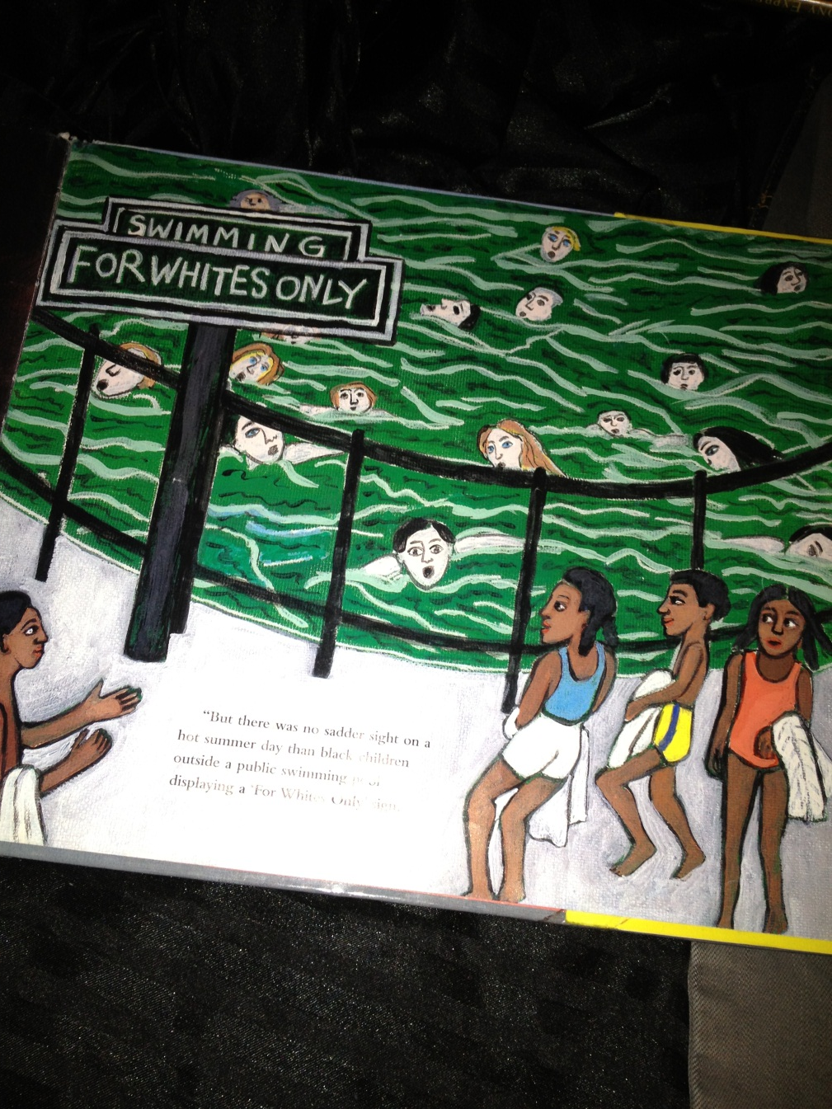
The kids were able to share some of their own life experiences based on the readings in the book

Slide 9
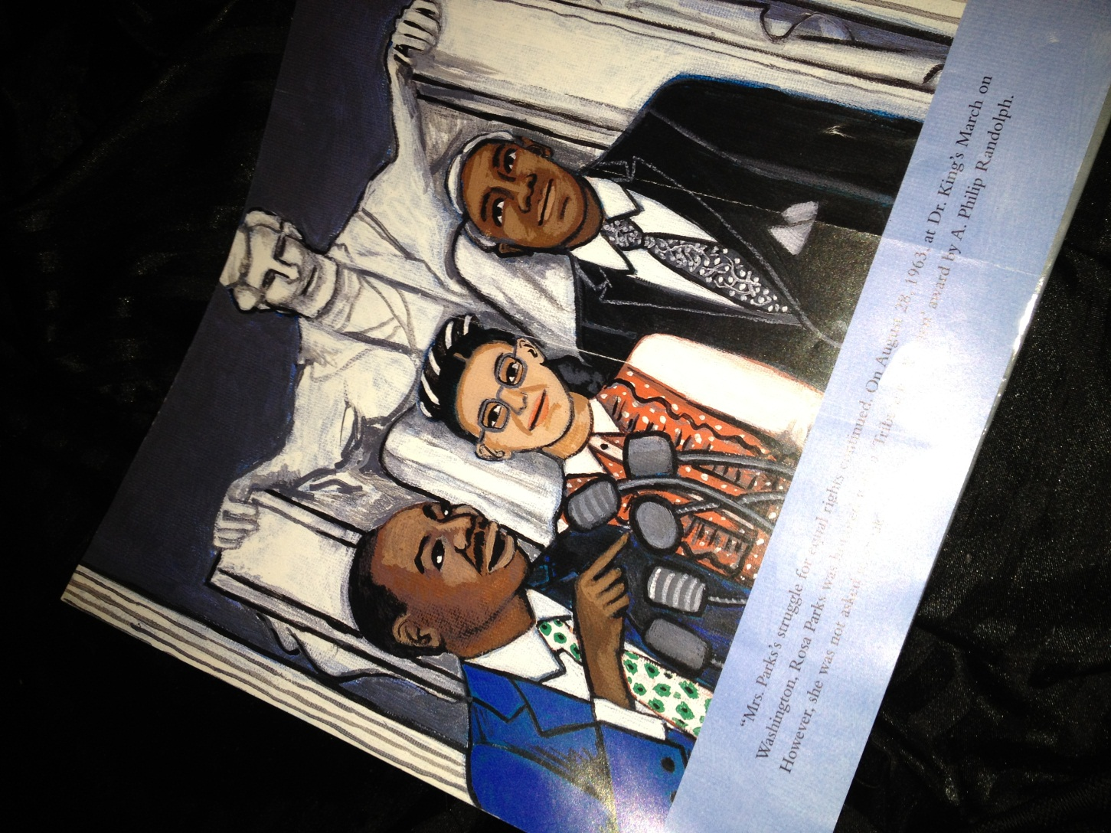
Only some students knew who Rosa Parks and Martin Luther King was before reading this story

Slide 10
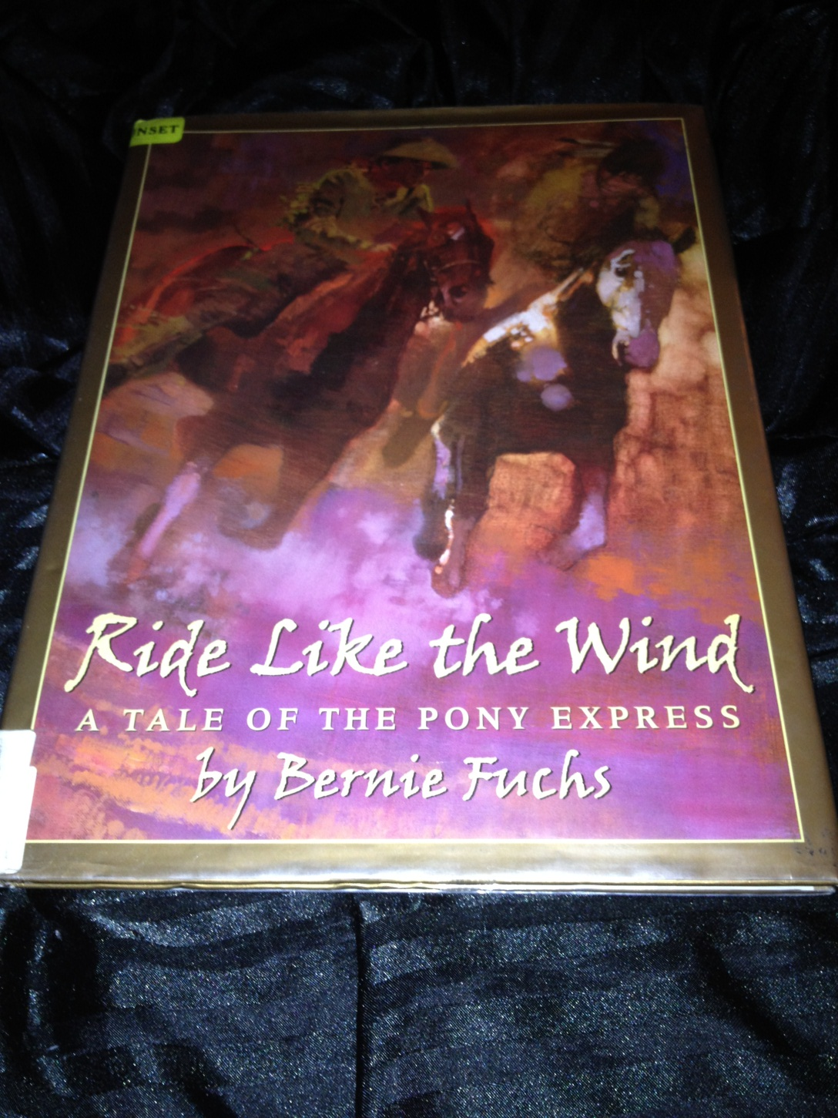
This next book not a single student knew about the stories of the Pony Express

Slide 11
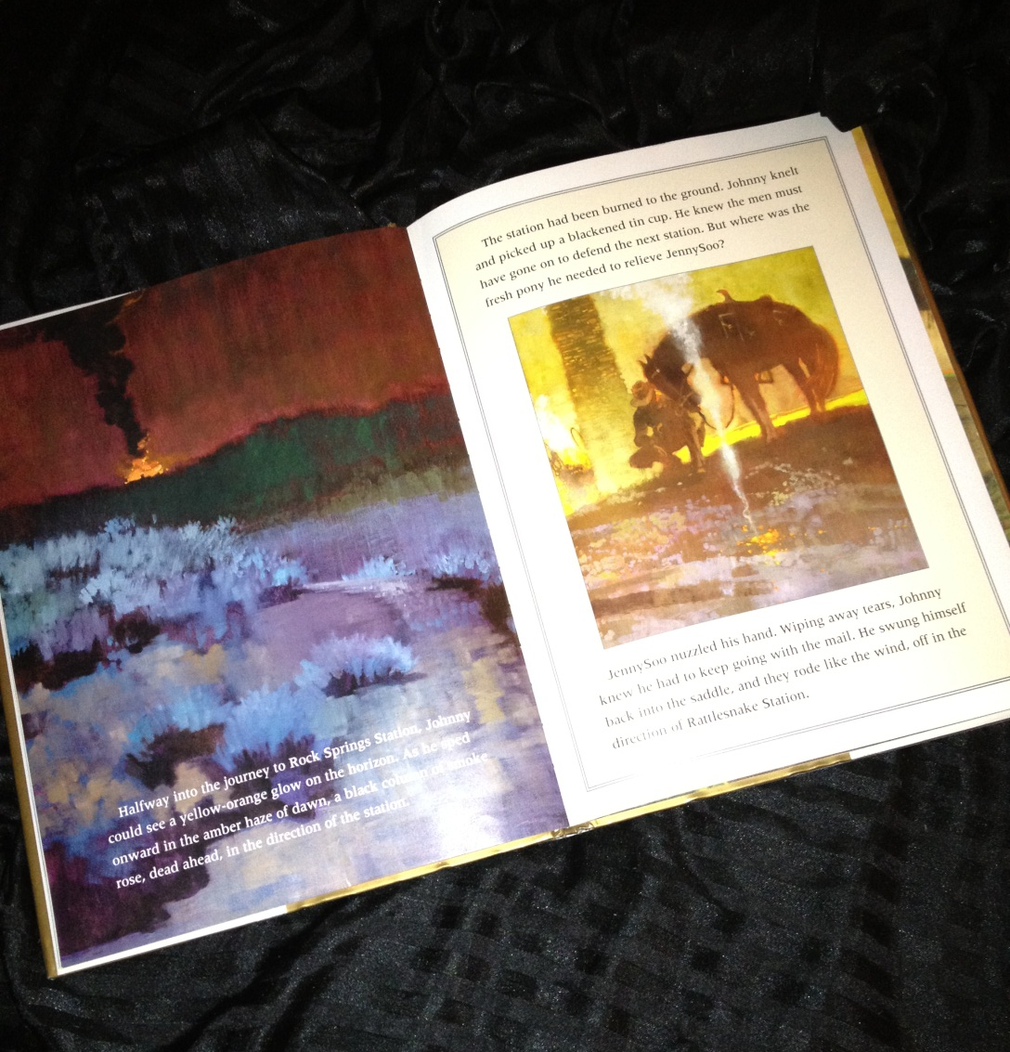
At this point the kids were able to point out specific vocabulary words and give their definitions.
They also understood the main issues and the different viewpoints of both sides of the issue.

Slide 12
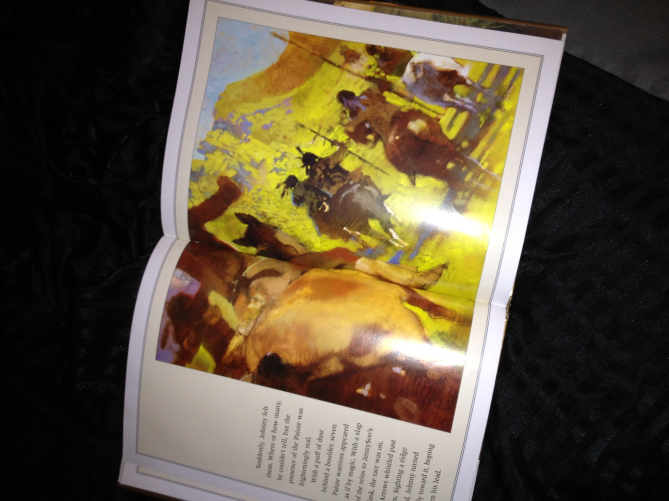
The students always remembered where we left off, mostly because of the books illustrations.

Slide 13
Rosa Parks Facts and Information
Born: February 04, 1913 in Alabama, United States, Tuskegee
Died: October 24, 2005 in Detroit, United States, Michigan
Nationality: American
Occupation: Civil rights activist
Married Raymond Parks in 1932
Rosa and Raymond Parks shared an interest in racial politics and often discussed the difficulties of black life in the segregated South.
As an icon of the civil rights movement, Parks is often mistakenly characterized as a simple woman who chose not to stand because she had tired feet. However, Parks had been resistant to bus segregation laws prior to the boycott and was well known in the black community for her active role in the local chapter of the National Association for the Advancement of Colored People (NAACP).

Slide 14
Reading Competencies
Apply reading skills and study skills for textbooks:
The SQ3R
Using Illustrations to guide you in your studying.
Focus on Headings, Bolded words, or main points.

Slide 15
Work Cited
Feldt, Ronald C., and Robert Hensley. "Recommendations for use of SQ3R in introductory psychology textbooks." Education 129.4 (2009): 584+. Gale Opposing Viewpoints In Context. Web. 25 June 2012.
Murphy, Blair L. "Rosa Louise McCauley Parks." Civil Rights in the United States. Ed. Waldo E. Martin, Jr. and Patricia Sullivan. Vol. 2. New York: Macmillan Reference USA, 2000. Gale Opposing Viewpoints In Context. Web. 25 June 2012.

